Slide 1
CARBON ISOTOPES

Slide 2
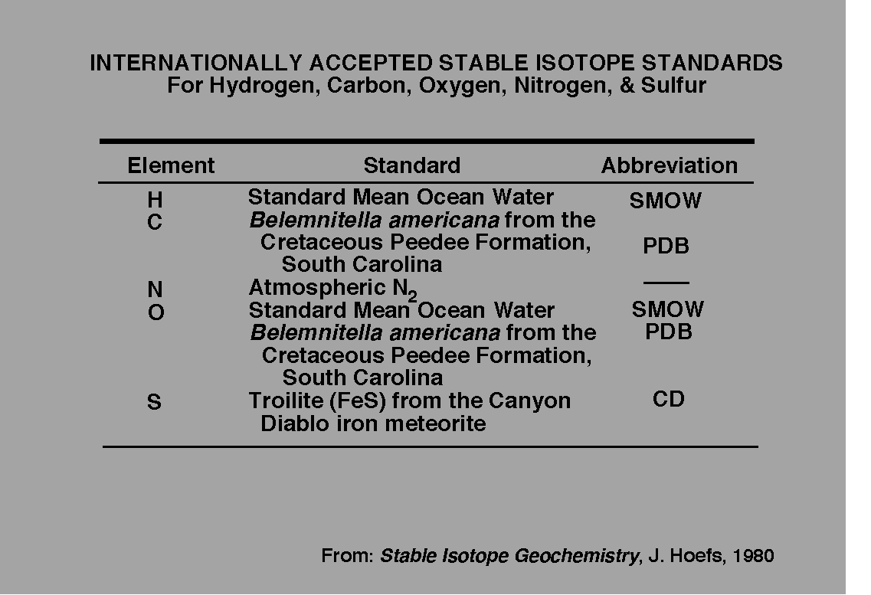
Standards Vary

Slide 3
¹²C 98.89‰
¹³C 1.11‰
3 basic, fairly stable isotopes of Carbon, C¹², C¹³, and C¹⁴ C¹⁴ is present only in trace amounts & breaks down
to N¹⁴ over time, leaving only 2 stable isotopes

Slide 4
2 basic isotopes of stable Carbon, C¹² and C¹³ isotopes
Carbon exists in oxidized, elemental and reduced forms.

Slide 5
2 basic isotopes of stable Carbon, C¹² and C¹³ isotopes
Carbon exists in oxidized, elemental and reduced forms.
As in the case of almost all compounds, the heavy isotope,
C¹³ becomes concentrated in the more oxidized forms.

Slide 6
2 basic isotopes of stable Carbon, C¹² and C¹³ isotopes
Carbon exists in oxidized, elemental and reduced forms.
As in the case of almost all compounds, the heavy isotope,
C¹³ becomes concentrated in the more oxidized forms.
The metabolic reduction of carbon (into organics) strongly
partitions the C¹² and concentrates the C¹² in the organics.

Slide 7
2 basic isotopes of stable Carbon, C¹² and C¹³ isotopes
Carbon exists in oxidized, elemental and reduced forms.
As in the case of almost all compounds, the heavy isotope,
C¹³ becomes concentrated in the more oxidized forms.
The metabolic reduction of carbon (into organics) strongly
partitions the C¹², leaving the C¹³ in the more oxidized forms
and concentrates the C¹² in the organics.
Assuming that most of the original C on Earth began as
volcanic CO₂ emissions, massive biologically induced
reduction of carbon led to the concomitant production of
the free oxygen (O₂) present in the atmosphere today.

Slide 8
THE PRESENT (LATE ARCHEAN ONWARD) AND
MOST COMMON BIOLOGICAL CARBON CYCLE
INVOLVES THE UTILIZATION OF CO₂
TO MAKE ORGANIC MATTER
IT REQUIRES THE PRESENCE OF AN OXIDANT,
O₂ OR SO₄
IT IS IS DRIVEN EITHER CHEMICALLY
OR BY “SOLAR-POWER”
AND CONVERTS THE CO₂ TO ORGANIC MATTER
2

Slide 9
THIS PROCESS, IS USUALLY (BUT NOT ALWAYS)
DRIVEN BY SOLAR ENERGY,
IN A LOW TEMPERATURE
REDUCTION OF OXIDIZED CARBON,
PROCESSED PRIMARILY BY
PHOTOSYNTHETIC FIXATION OF CO₂
UTILIZING THE
CALVIN CYCLE

Slide 10
THE PRINCIPAL PATHWAYS OF
AUTOTROPHIC CARBON ASSIMILATION
ARE ACCOMPANIED BY MARKED FRACTIONATION
OF THE STABLE CARBON ISOTOPES
¹²C AND ¹³C
“AN AUTOTROPH IS AN ORGANISM CAPABLE OF MAKING
NUTRITIVE ORGANIC MOLECULES FROM INORGANIC SOURCES
VIA PHOTOSYNTHESIS (INVOLVING LIGHT ENERGY) OR
CHEMOSYTHESIS (INVOLVING CHEMICAL ENERGY)”

Slide 11
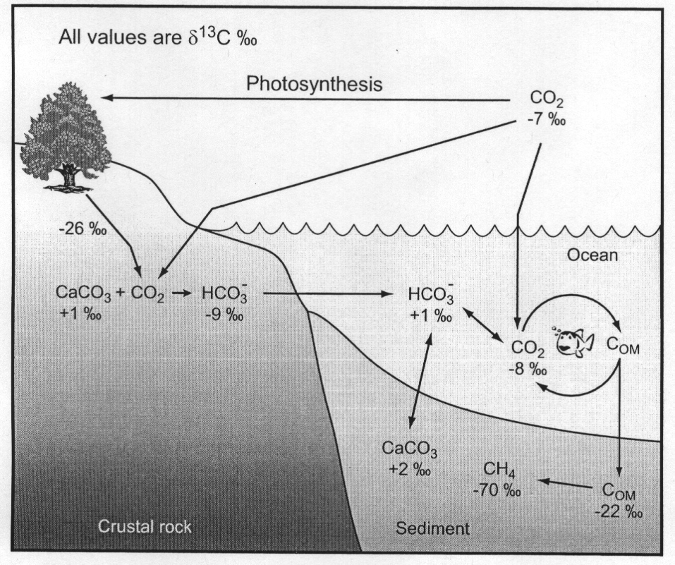

Slide 12
C3 organisms = plants such as beans, potatoes,
rice, wheat
Crassulacean Acid Metabolism (CAM)
(brown and green algae)
C4 organisms = trees, corn

Slide 13
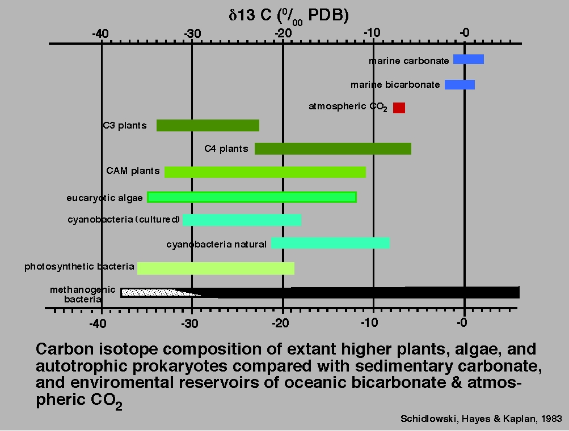

Slide 14
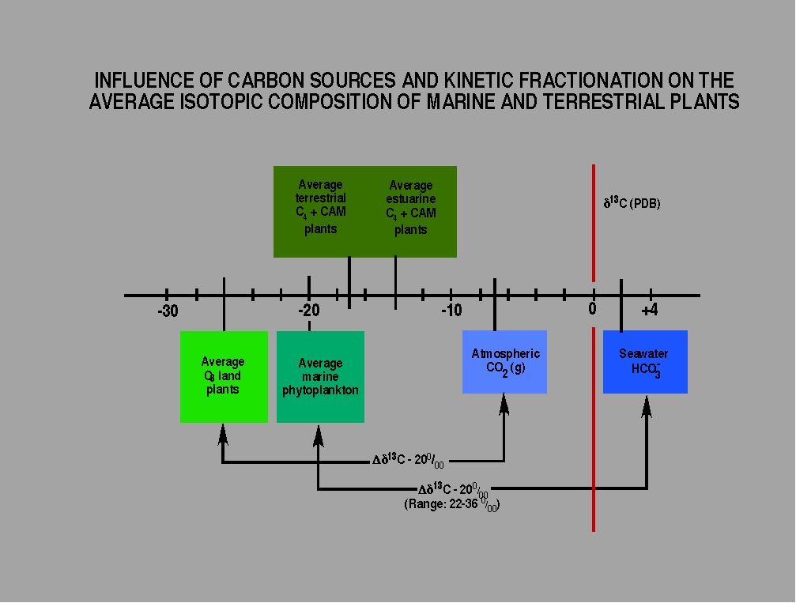

Slide 15
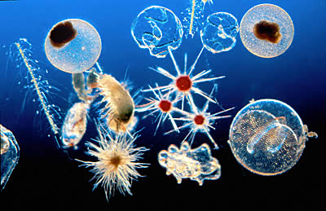
Isotope Basics
Steady-state, non-equilibrium carbon isotope fractionation
between the Total Dissolved Carbon (TDC) in the shallow and deep ocean due to high biological activity in the near-surface photic zone of the ocean. Photosynthesizing organisms preferentially incorporate ¹²C in their tissues
Organic C Pool
Inorganic C Pool
C¹²
C¹²
C¹³
C¹³
C¹²
C^{13/12}O₃²⁻
Ca²⁺
C¹²
C¹³
CaCO₃
C¹²
C¹²
C¹²
C¹²
Carbonate precipitation
C¹²
C¹²
C¹²
Anoxic/Dysoxic
C¹²
Burial of organic carbon

Slide 16
Isotope Basics
Steady-state, non-equilibrium carbon isotope fractionation
between the Total Dissolved Carbon (TDC) in the shallow and deep ocean due to high biological activity in the near-surface photic zone of the ocean. Photosynthesizing organisms preferentially incorporate ¹²C in their tissues
This leaves more ¹³C in the remaining water (surface) and
a greater amount of ¹²C in the bottom deposits (1-2%)
Organic C Pool
Inorganic C Pool
C¹²
C¹²
C¹³
C¹³
C¹²
C^{13/12}O₃²⁻
Ca²⁺
C¹²
C¹³
CaCO₃
C¹²
C¹²
C¹²
C¹²
Carbonate precipitation
C¹²
C¹²
C¹²
Anoxic/Dysoxic
C¹²
Burial of organic carbon

Slide 17
Residence time
& reservoirs

Slide 18
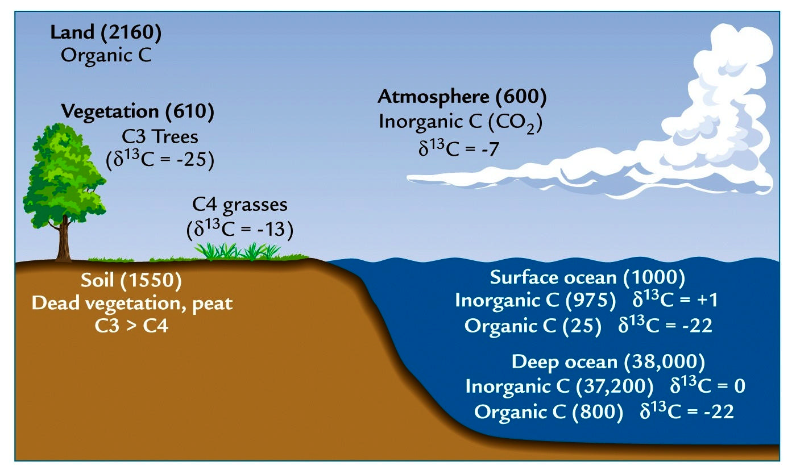
Size and δ¹³C (vs PDB) of Earth’s Carbon Reservoirs
Carbonate sedimentary rocks (60,000)
δ¹³C = 0 to -1
Carbon cycle showing approximate amounts, fluxes and δ¹³C
values of different reservoirs. Abundances are given in (10¹⁵g)

Slide 19
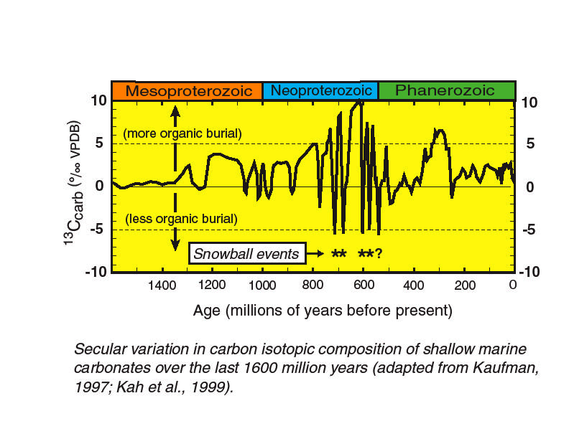
δ¹³C in the Carbonate Rock Record

Slide 20
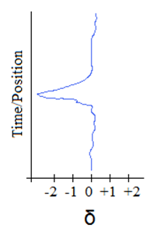
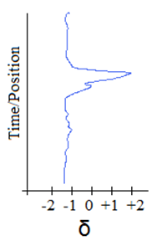
δ¹³C is sensitive to paleoenvironmental changes
- biological productivity
- ocean circulation
- organic carbon burial
Decreased
biological
productivity
Increased
mixing or
upwelling
Increased
weathering of
organic
carbon
Increased
biological
productivity
Decreased ocean
circulation
Increased
organic
carbon
burial
Negative shift =
Depleted in ¹³C
Positive shift = Enriched in ¹³C

Slide 21
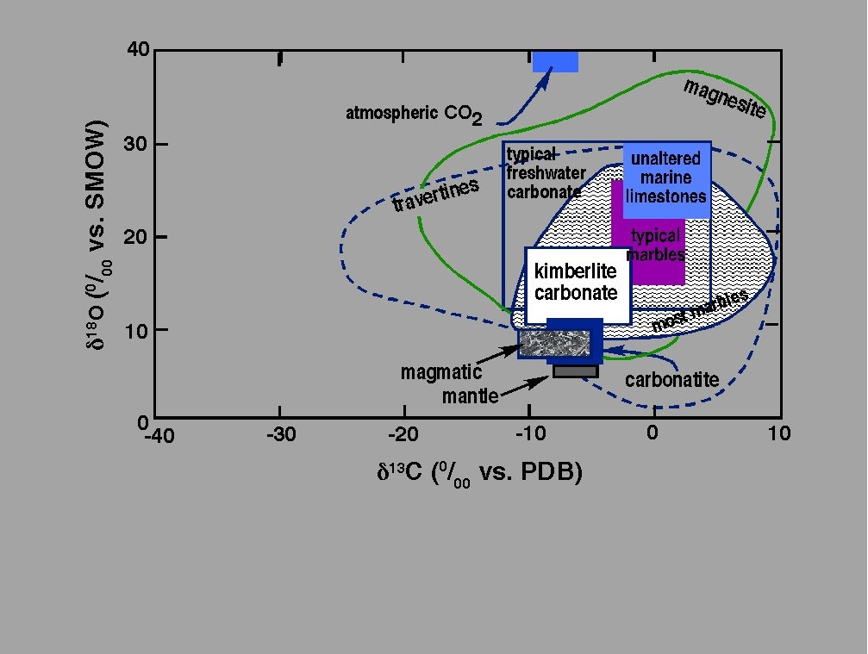
Sharp, 2007, Fig 7.2

Slide 22
EXPLAIN PLANT TYPES

Slide 23
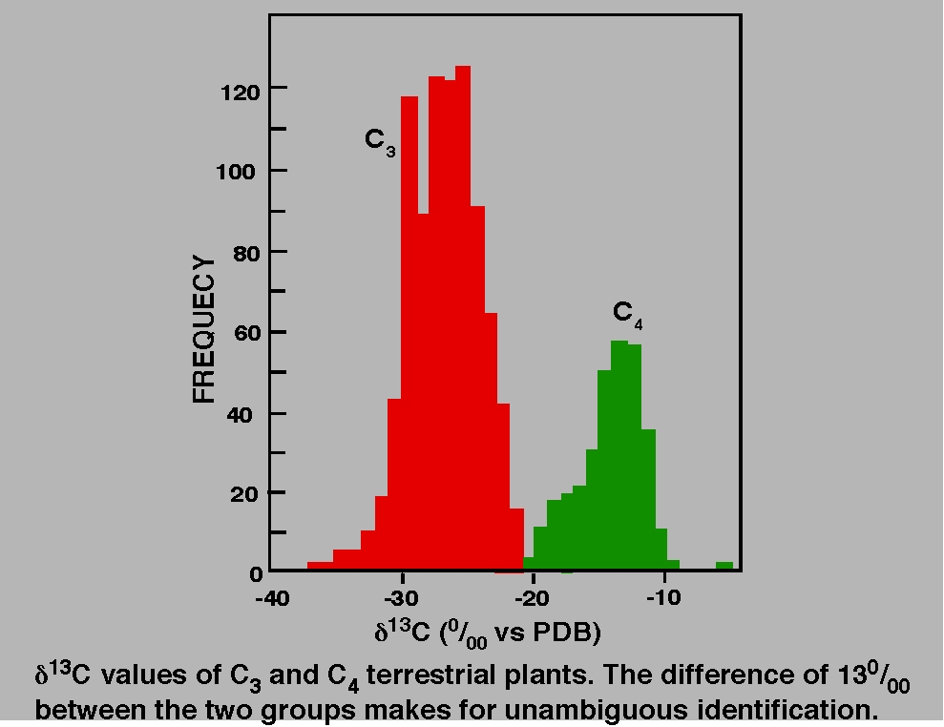

Slide 25
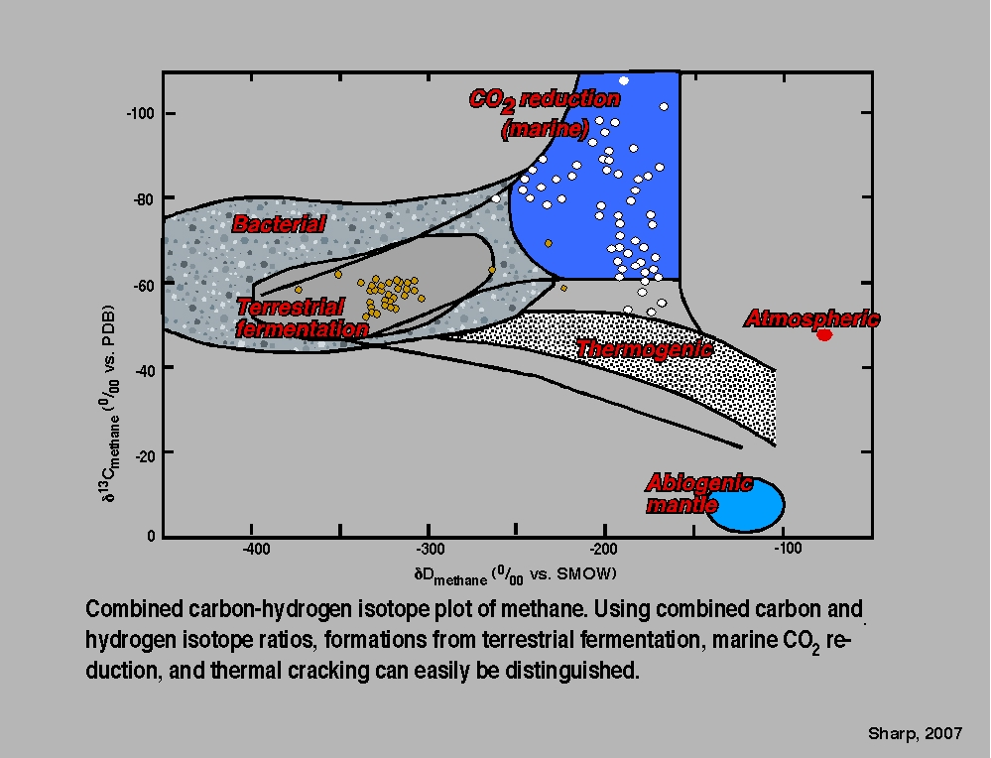

Slide 26
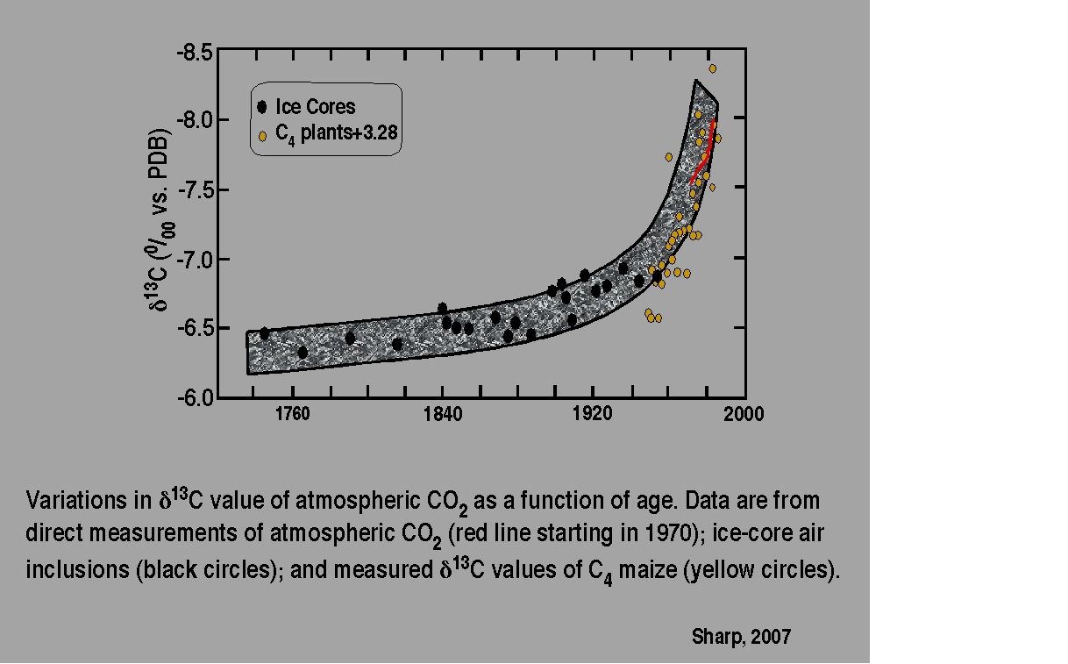

Slide 27
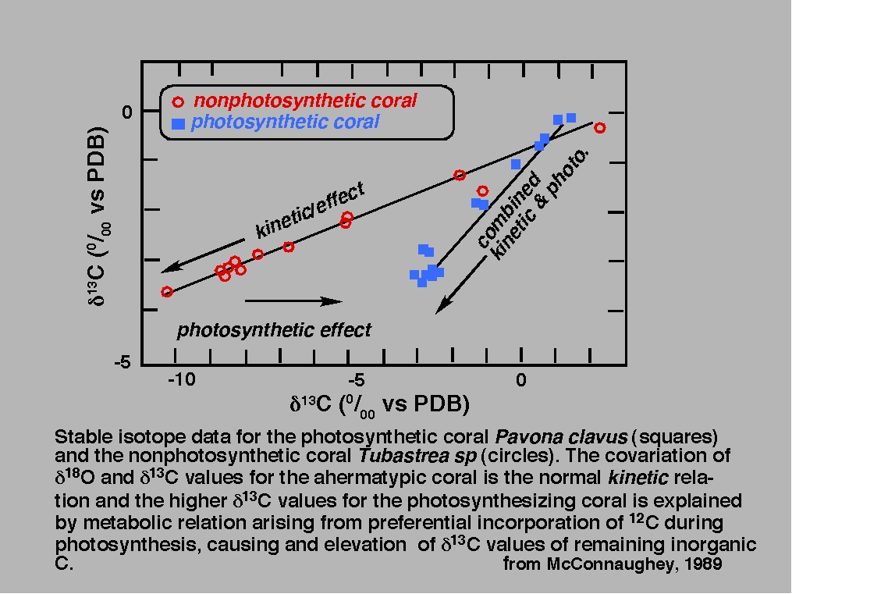

Slide 28
